Slide 1
SkillSight
identifying explicit and implicit skills from resume excerpts.
Multi label classification
PRESENTED BY:
Yonatan Elman
Michael Kovalchuk
Roni Fadlon

Slide 2

How resume screening works today?
Many resumes (~250/job)
ATS screening needed
Keyword-based filtering
Implicit skills not recognized (experience described indirectly)
False negatives: qualified candidates filtered out
The system optimizes for keyword matches, not skill fit - so real talent is missed

Slide 3

SkillSight: Making Implicit Skills Visible
Implicit tech skills: detect software/engineering skills from resume/JD context, even if not written.
Beyond keywords: use semantic understanding instead of keyword matching.
Clear labels: separate Explicit vs Implicit technical skills.
Synthetic data: train and evaluate on a curated synthetic dataset of software/engineering resumes and job descriptions.
Practical output: return a focused tech-skill profile to reduce noise and missed candidates.

Slide 4
Explicit & Implicit Skills in Tech Resumes: A Quick Example
JD: “I wrote complex SQL queries to build a star schema for analytics-defining fact and dimension tables and optimizing joins for reporting.”
Explicit: SQL
Implicit: Dimensional Modeling

Slide 5
SkillSight Pipeline Overview
Define Tech Skills List
Build Skill Bundles
Generate Synthetic Dataset by GPT 4o- mini
Zero-Shot Baseline by GPT 4o- mini
Train & Evaluate Models
Metrics & Results
3500 examples
Pairwise
One-pass
recall
precision
F1

Slide 6
End-to-End: Data • Models • Metrics
Data:
3,500 synthetic, controlled examples (JD-like)
Fixed global skill list across all samples
Each example is built around 3–6 skills sampled from the global list (via skill bundles)
Per-skill labeling: NONE / IMPLICIT / EXPLICIT
Example from the Dataset:
"job_description": "In my previous role…. , ultimately enhancing the overall educational experience we provided.",
"skills": {"Bash": 1.0, "PowerShell": 1.0, "Pulumi": 0.5, "Terraform": 0.5, "Perl": 0.5, "Azure": 0.5}

Slide 7
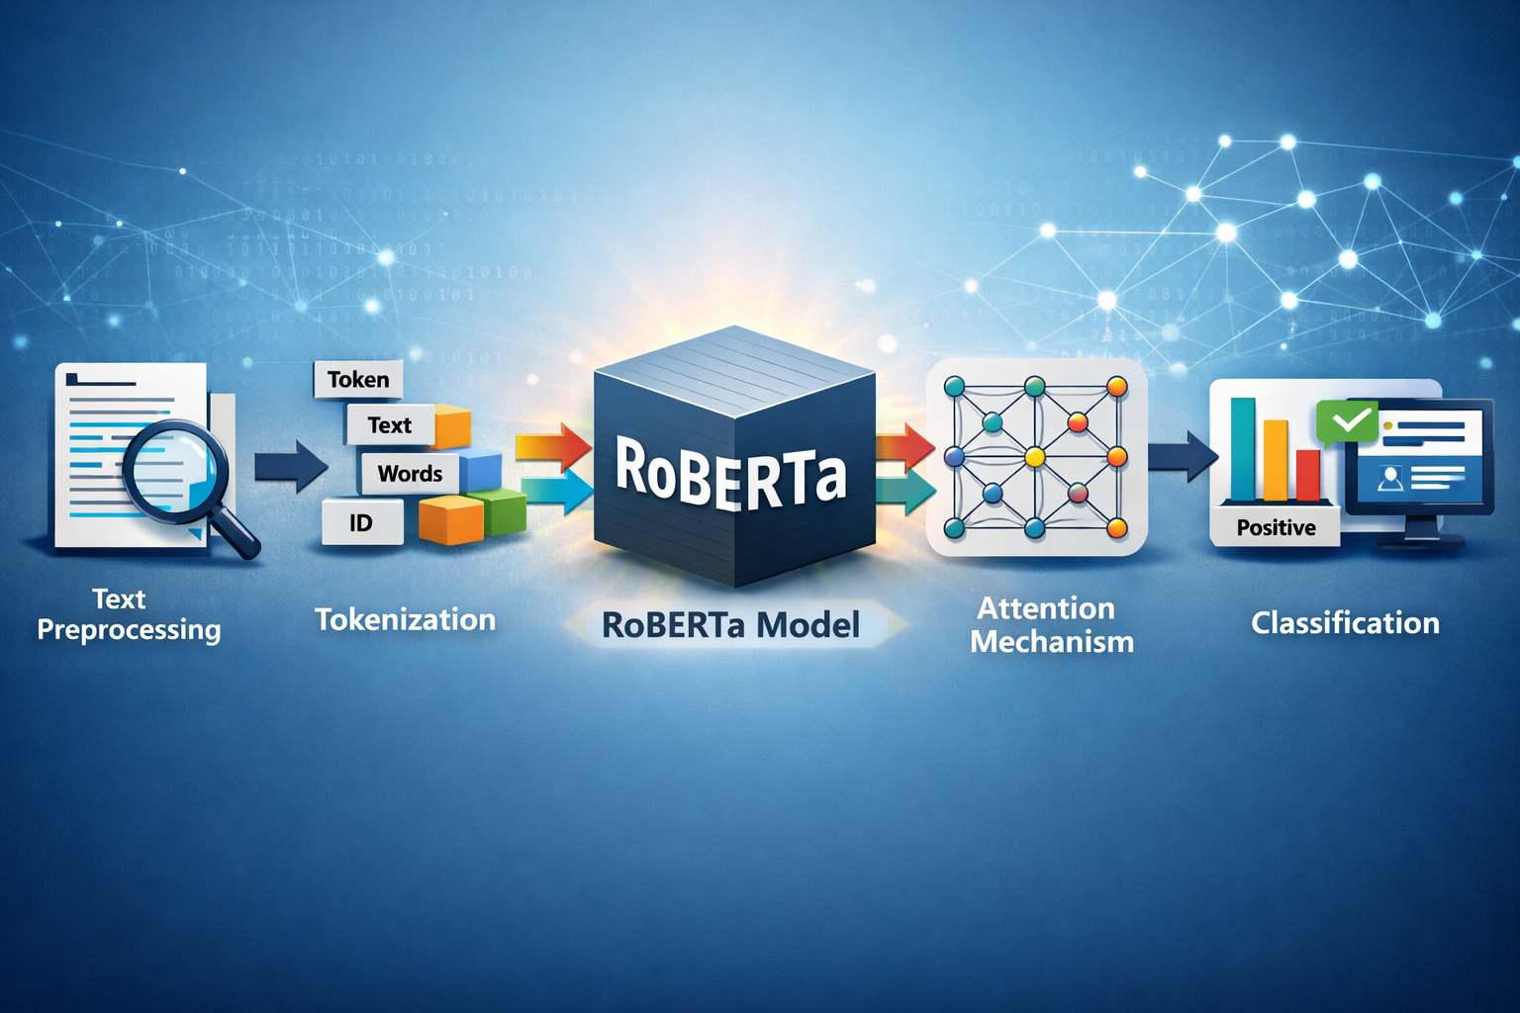
End-to-End: Data • Models • Metrics
Models:
We compare a zero-shot LLM baseline to a RoBERTa model fine-tuned on our synthetic dataset.
Baseline- GPT-4o-mini (zero-shot, no fine-tuning)
Fine-tuned model:
Backbone: RoBERTa:
Training strategies: – One-Pass (no class weights) – One-Pass (class weights) – Pairwise

Slide 8
Approach overview: Pairwise vs One-Pass
Input:
JD X
Skill 1, skills 2,skill 3… skill n
Pairwise
One-Pass
JD X
Skill 1
Implicit/explicit/none
JD X
Skill 1
Implicit/explicit/none
Skill 2
Implicit/explicit/none
JD X
Skill 2
Implicit/explicit/none
Skill 3
Implicit/explicit/none
…
JD X
Skill 3
Implicit/explicit/none
Skill n
Implicit/explicit/none
…
JD X
Skill n
Implicit/explicit/none
Output:
JD X
Skills (non-none)+ implicit/explicit
One-Pass runs once per JD (fast); Pairwise runs once per skill (more accurate, slower).

Slide 9
End-to-End: Data • Models • Metrics
Metrics:
Precision – Of the skills the model predicted, what fraction are correct.
Recall – Of the true skills in the resume/JD, what fraction the model successfully finds.
F1 – A single score that balances Precision and Recall.
Typed scoring: a prediction counts as correct only if both the skill and its label match (IMPLICIT / EXPLICIT).
Example:
GT: {SQL, AWS, Docker, Git}
Pred: {SQL, AWS, Linux, Git, Kubernetes}
Precision –3/5→60%
Recall – 3/4 →75%
F1 – 2 * (Precision * Recall) / (Precision + Recall)→0.9/1.35 ≈ 0.67→67%

Slide 10
Our Path to High-Quality Results:
Controlled data: ~3,500 synthetic examples with controlled skill coverage in the text.
Consistent labeling: each skill in a sample is labeled as EXPLICIT or IMPLICIT.
Fair evaluation: separate Train / Val / Test splits.
Systematic comparison: zero-shot baseline vs. RoBERTa under multiple training variants.

Slide 11
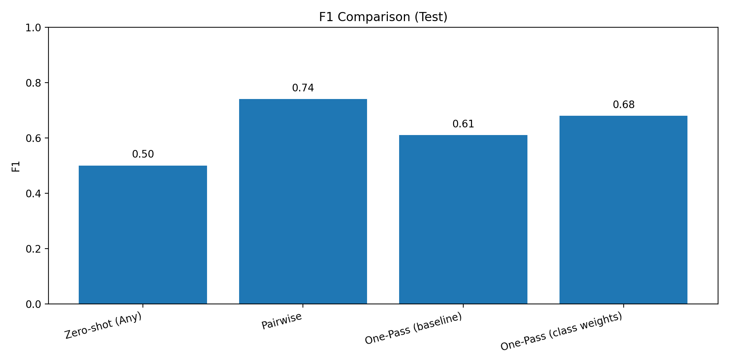
Results:
Model | Precision | Recall | F1
GPT-4o-mini (zero-shot) | ~55% | ~47% | ~50%
RoBERTa One-Pass | ~66% | ~60% | ~61%
RoBERTa One-Pass + weights | ~65% | ~73% | ~68%
RoBERTa Pairwise | ~67% | ~87% | ~74%

Slide 12
Conclusion:
Achieved desired results:
Clear improvement over the zero-shot baseline.
Pairwise performed best; One-Pass is faster.
What we’d do differently?
Expand the dataset beyond 3,500 samples to increase coverage and diversity.
Add additional seeds/runs to verify stability, not rely on a single run.
Future ideas:
Scale up the skill taxonomy toward a larger global list.
Evaluate on real resumes/JDs to test generalization.

Slide 13
Thank You

